Slide 1
* This Webinar is Being Recorded *
Webinar: Overview
of the Newly Adopted
Alaska Social Studies Standards
Alaska Department of Education and Early Development
Curtis Jensen, ELA / Social Studies Content Specialist
March 2025

Slide 2
Part 1:
Framing & Introduction

Slide 3
Framing
Objective: We will…
Introduce the new ELA / Social Studies Content Specialist
Unpack regulatory context for the new AK Social Studies Standards
Unpack the 4 Key Shifts of the newly adopted AK Social Studies Standards
**Use and highlight some low-prep, high-leverage literacy best practices as we go**
Close: I will…
Summarize:
The 4 Key Shifts of the newly adopted AK Social Studies Standards
Key takeaways from this webinar
Launch:
Download the Implementation Checklist

Slide 4
Content Specialists: Norms & Expectations
So that we have a productive and respectful meeting, please:
Rename yourself in the chat: First name, Last Name, District
Use considerate & respectful speech in breakout rooms, discussions, chat, etc
Be mindful of air time
Be open to perspectives and positions which aren’t your own
Camera on
Plan on participating
Reflective quiet moments are valuable!!
Be present and focused on the important work and time we share together

Slide 5
Quick Intro: Curtis Jensen curtis.jensen@alaska.gov
AK Educator Experience:
AK DEED: ELA / Social Studies Content Specialist (from July 1, 2024)
Fairbanks: FNSBSD Instructional Coach (Districtwide, Nordale Elementary), ELL Specialist (North Pole+)
Sand Point: AEBSD G7-12 ELA Teacher
Koliganek: SWRSD G6-12 ELA Teacher
Educator Experience outside AK:
Massachusetts: Alma del Mar Public Charter School (Curriculum Designer & G8 Language Arts)
Utah: South Davis Junior High School (G9 Geography, G7-9 Creative Writing, G8 ELA)
Utah: Utah Valley University (Freshman Writing)
New York: Brooklyn College, Kingsborough Community College (Freshman Composition)
Ukraine: Zaliztsi Specialized Secondary School (Peace Corps TEFL 2006-2008)
Education:
BA English / History: University of Utah
MFA Poetry: Brooklyn College

Slide 6
How Content Specialists can support implementation of new standards:
**Provide guidance on the standards**
Provide resources and documents (FAQ’s, checklists, rubrics, recorded webinars, PD Modules, ELL Resources)
Support school districts in reviewing, unpacking, and implementing Alaska state standards
Share evaluative tools for curriculum review, renewal cycles, choosing instructional materials
Support alignment of standards, content, and assessment

Slide 7
Many of the following slides are taken from:
PD Module 1 Instructional Shifts

Slide 8
Warm up:
Chat Waterfall:
Write your response in the chat
Don’t press enter till the instructor says so
Everyone submits their response at once
Prompt:
List:
- Your Name
- Your School / district
- What you already know about the Newly Adopted Alaska Social Studies Standards

Slide 9
Part 2:
Unpack regulatory context for the newly adopted AK Social Studies Standards

Slide 10
Alaska State Board of Education has adopted new Alaska Social Studies Standards
2023 AK DEED partners with American Institutes for Research to develop new Alaska Social Studies Standards
  Process includes multiple working groups comprised of Alaska Educators and statewide partners.
  For more info: AK Soc Stu Standards Process Writing Guide
Oct 9, 2024: draft standards presented to State Board of Ed (worth reviewing: Oct 9 Board Presentation)
Dec 5, 2024: AK State Board of Ed adopts new Soc Stu standards
Jan 2025: AK Social Studies Standards Toolkit roll out begins
1998 Original Social Studies Standards are adopted (regulation)
Feb 2021: Review process begins for AK Social Studies Standards
June 2021: Fordham National Social Studies Standards Report Released: AK receives F’s

Slide 11
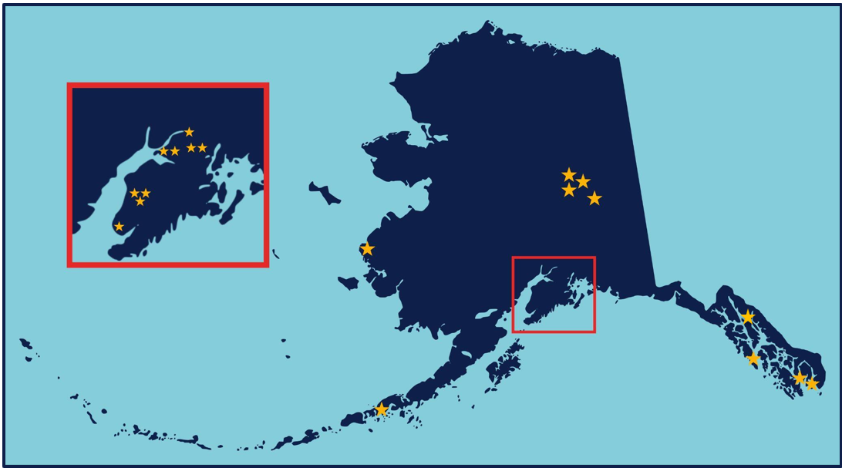
EWG Workgroup District
“… A diverse group of individuals that represented a wide variety of experiences and perspectives in Alaska were involved throughout the standards revision process. Participants represented the following towns/cities: Anchor Point, Soldotna, Anchorage, Eagle River, Chevak, Teller, Juneau, Metlakatla, Fairbanks, King Cove, Chugiak, and North Pole.”

Slide 12
AK Education: Regulation vs Statute
*Regulation:
Regulations are passed by AK State Board of Education
Examples:
AK Studies Requirement
New AK Soc Stu Standards
*Statute:
State Law passed by:
3 readings in both houses (legislature and senate)
Signed by governor (or not)
Bill > Act > Law
Examples in AK Education:
- Bree’s Law
- AK Reads Act

Slide 13
Alaska Education Regulation: Visual Progression
Districts develop local policies and processes to implement statewide regulations
State Board Adopts statewide regulation
Department of Education develops guidance and supporting documents to support districts in implementation of statewide regulations
**The State Board cannot supersede state law, they can merely create regulation for implementation of state law.
**Local control: Alaska education governance is executed primarily through locally elected officials whenever possible (includes schools)

Slide 14

Strategic Priorities:
Alaska’s Education Challenge
Five Shared Priorities:
Support all students to read at grade level by the end of third grade.
Increase career, technical, and culturally relevant education to meet student and workforce needs.
Close the achievement gap by ensuring equitable educational rigor and resources.
Prepare, attract, and retain effective education professionals.
Improve the safety and well-being of students through school partnerships with families, communities, and tribes.
education.alaska.gov/akedchallenge
Notes:
Alaska’s Education Challenge Priority #3 asks us to: Close the achievement gap by ensuring equitable educational rigor and resources. A key to meeting this priority is ensuring that we have rigorous standards that are aligned to national standards and best practices in the field of study while also reflecting the local Alaska cultural and geographic contexts.

Slide 15
The Relationship of Standards to Classroom Instruction
Standards
Broad goals articulating what students should know, understand, and be able to do over a given time period.
State
Curriculum
An organized plan of instruction: a sequence of instructional units.
Local Districts
Instruction
Learning experiences designed to meet the needs of students.

Slide 16
Stop & Synthesize:
Chat Waterfall
Prompt:
List:
1-3+ key takeaways from the previous slides.
Not sure what to write? Here are some prompts:
Square: Something I heard that squares with my beliefs:
Circle: A question going around in my head:
Triangle: Three points I want to remember:
**Extra Credit: Explain why each takeaway is important in a COMPLETE SENTENCE!?!**
Chat Waterfall
Write your response in the chat
Don’t press enter till the instructor says so
Everyone submits their response at once

Slide 17
Part 3:
Unpack 4 Key Shifts of the newly adopted AK Social Studies Standards

Slide 18
Newly Adopted AK Social Studies Standards: Key Instructional Shifts
1. Thematic Social Studies Content and Skills | 2. Incorporate and Honor Alaska History and Tribal Government | 3. Understand Social Studies through Inquiry | 4. Develop Civic Knowledge, Skills, and Dispositions
Students build deep social studies content knowledge and skills by connecting learning thematically across disciplines. | Students engage with content that reflects their state’s diverse communities, cultures, perspectives, and voices across the social studies disciplines. | Students engage in productive struggle by investigating and asking questions grounded in social studies content and skills. | Students consistently develop and engage with civic knowledge, skills, and dispositions to become active and informed citizens.
**Pause for questions and discussion**

Slide 19
Shift: Thematic Social Studies Content & Skills
1. Thematic Social Studies Content and Skills
Students build deep social studies content knowledge and skills by connecting learning thematically across disciplines.
Key Message:
Organizing topics and concepts under themes helps move beyond rote memorization of facts to a recognition of patterns and understanding of connected ideas.
Major Shift:
From encountering siloed information to ensuring the transfer of knowledge and understanding across interrelated topics and concepts.

Slide 20
Let’s Break That Down
Sourcewww.nysed.gov/common/nysed/files/programs/curriculum-instruction/nys-ss-field-guide.pdf
FROM a Social Studies Classroom Where... | TO a Social Studies Classroom Where…
Students experience textbook-focused instruction. | Students learn to read, discuss, and write like social scientists.
Students develop literacy skills and social studies practices separately. | Students develop disciplinary literacy skills and social science practices in tandem.
Students learn content knowledge. | Students integrate and apply concepts, skills, and content knowledge.

Slide 21
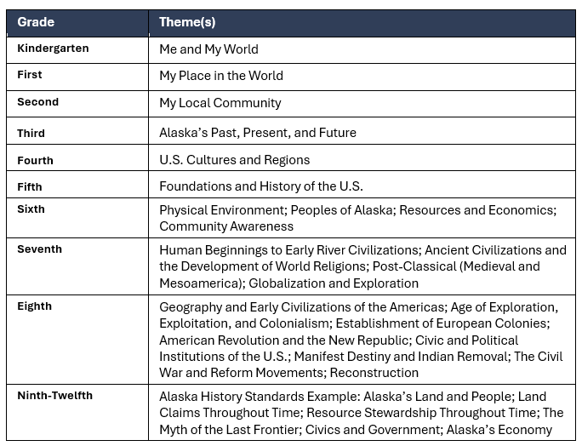
Organization of K-12 Standards by Themes
Notes:
Emphasize that the 9-12 Alaska History standards are also guided by time periods and timeframes.

Slide 22
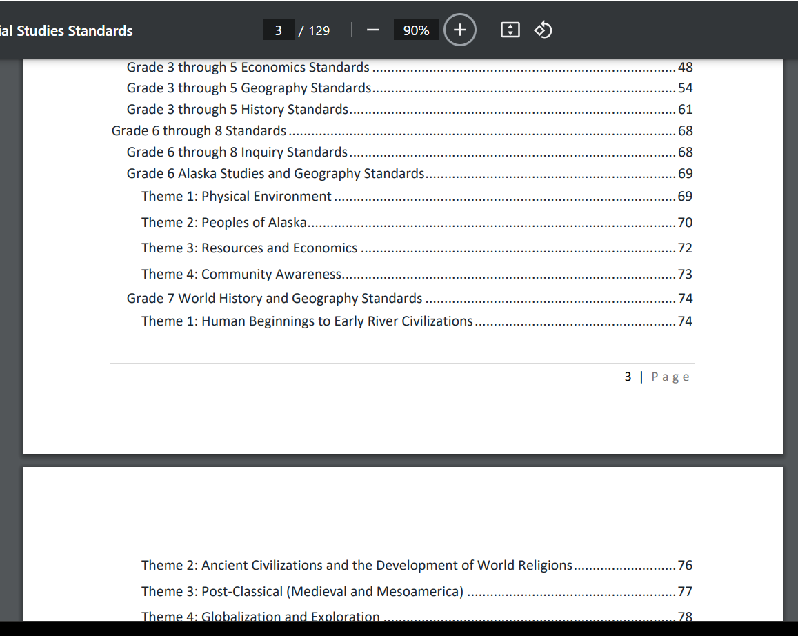
Themes:
Examples from Index

Slide 23
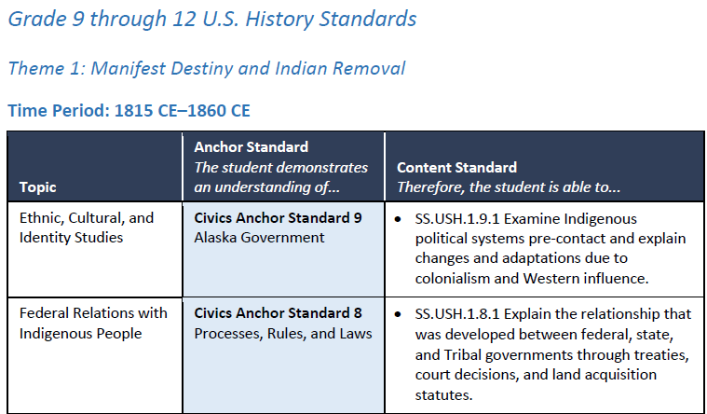
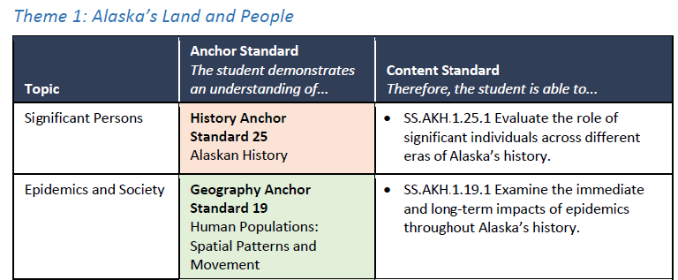
Themes: High School Example

Slide 24
Incorporate and Honor Alaska History and Tribal Government
2. Incorporate and Honor Alaska History and Tribal Government
Students engage with content that reflects their state’s diverse communities, cultures, perspectives, and voices across the social studies disciplines.
Key Message:
Emphasizing the Alaska context ensures an excellent education and equitable representation for every student.
Major Shift:
From limited content on Alaska History, Tribal Government, and Indigenous histories to intentionally recognizing and honoring Alaska’s diverse communities, histories, and unique systems of government throughout K-12.

Slide 25
Example Alaska History-Specific Standards
Civics | Economics | Geography | History
Anchor Standard 7 Participation and Deliberation | Anchor Standard 12 Decision-Making and Personal Finance | Anchor Standard 17 Global Interconnections: Changing Spatial Patterns | Anchor Standard 22 Historical Sources and Evidence
Anchor Standard 8 Processes, Rules, and Laws | Anchor Standard 13 The National Economy | Anchor Standard 18 Geographic Representations and Reasoning | Anchor Standard 23 Change, Continuity, and Context
Anchor Standard 9 Alaska’s Governments | Anchor Standard 14 The Global Economy | Anchor Standard 19 Human Populations: Spatial Patterns and Movement | Anchor Standard 24 Historical Thinking
Anchor Standard 10 Rights, Rules, and Responsibilities of Citizens | Anchor Standard 15 Alaska Economies: State, Local, and Tribal | Anchor Standard 20 Geography of Alaska | Anchor Standard 25 Alaskan History
Takeway:
AK History standards embedded ACROSS all grade levels, not just in req’d AK Studies Classes

Slide 26
Stop & Synthesize:
Chat Waterfall
Prompt:
List: 1-3+ key takeaways from the slides on HONORING ALASKA HISTORY & TRIBAL GOVERNMENT, and THEMATIC SOCIAL STUDIES CONTENT
**Extra Credit: Explain why each takeaway is important in a COMPLETE SENTENCE!?!**
Chat Waterfall
Write your response in the chat
Don’t press enter till the instructor says so
Everyone submits their response at once

Slide 27
Understand Social Studies Through Inquiry
3. Understand Social Studies through Inquiry
Students engage in productive struggle by investigating and asking questions grounded in social studies content and skills.
Key Message:
Inquiry is teacher- and/or student-led and focused on compelling social studies content questions.
Major Shift:
From learning about social studies to engaging in social studies.

Slide 28
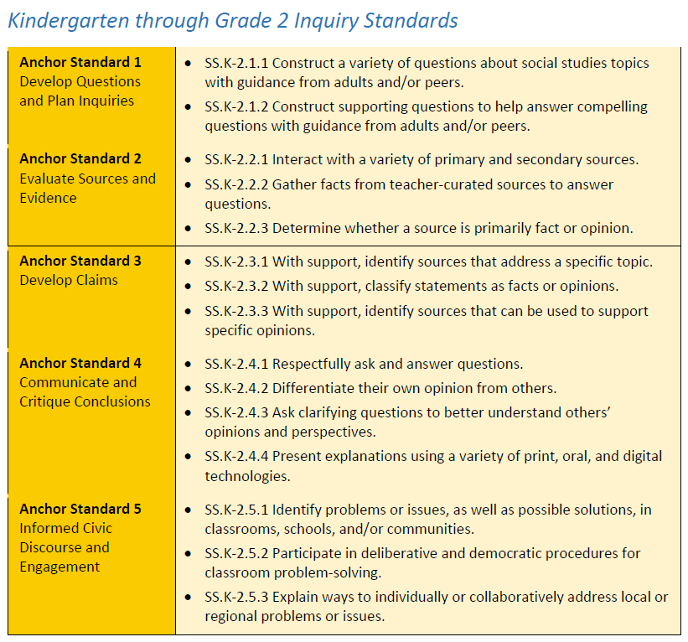
Example Inquiry Standards
Notes:
Note: K-5 and 9-12 have separate inquiry standards. Grades 6-8 also have separate inquiry standards, but intentionally incorporate the inquiry anchor standards into their themes where appropriate.

Slide 29
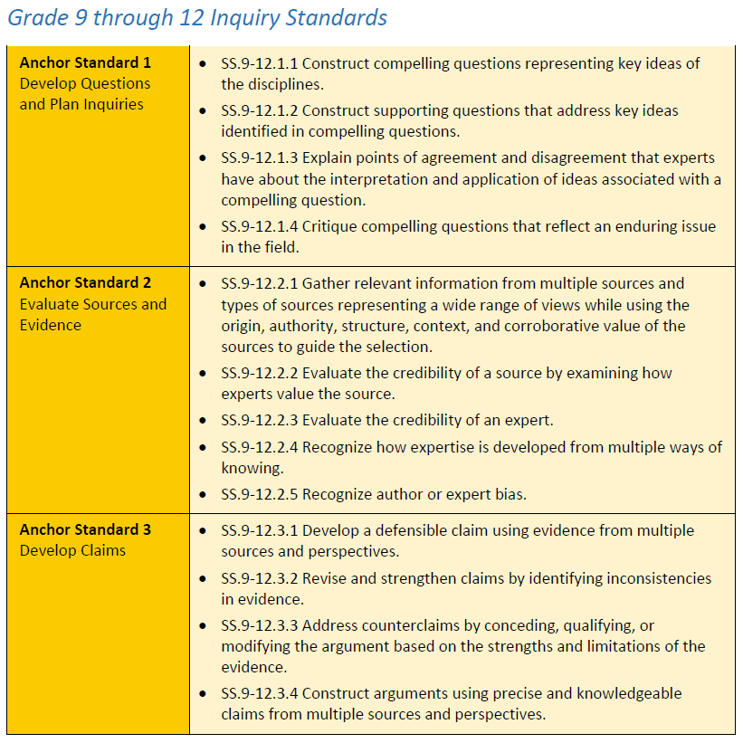
Example Inquiry Standards
Notes:
Note: K-5 and 9-12 have separate inquiry standards. Grades 6-8 also have separate inquiry standards, but intentionally incorporate the inquiry anchor standards into their themes where appropriate.

Slide 30
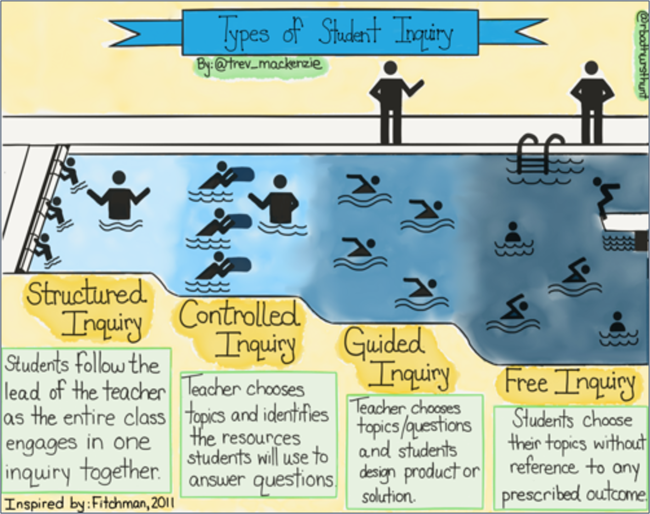
Types of Student Inquiry
Takeaway:
Inquiry can be intimidating, but remember: begin in the shallow end of a pool and gradually working our way up to the deeper end of the pool,
Focus on structured/controlled inquiry​ to set up students for success in later stages
Source: Trevor Mackenzie, https://www.trevormackenzie.com/elevate-resource

Slide 31
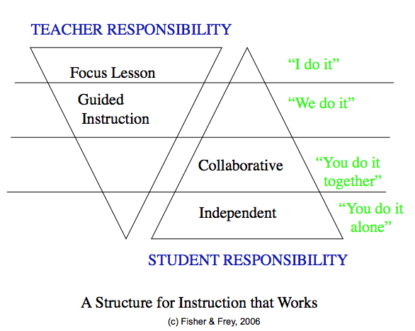
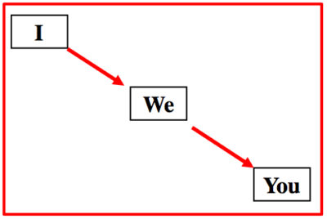
From: https://keystoliteracy.com/blog/differentiated-literacy-instruction-i-we-you/

Slide 32

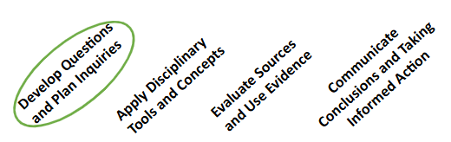
The C3 Inquiry Arc
Takeaway:
Successful student inquiry requires the four main components shown here.
Crafting questions that spark and sustain an inquiry is a key element to starting off the inquiry arc.
Questions developed at the start of an inquiry will need to be engaging enough to sustain interest throughout all four components in the process.​
*DEED will release teacher resources to support crafting questions in Spring 2025

Slide 33
Develop Civic Knowledge, Skills, and Dispositions
4. Develop Civic Knowledge, Skills, and Dispositions
Students consistently develop and engage with civic knowledge, skills, and dispositions to become active and informed citizens.
Key Message:
Civic education throughout K-12 is imperative for preparing students to engage in a more diverse, complex society.
Major Shift:
From separate government and citizenship standards to integrated civics knowledge, skills, and dispositions throughout K-12.

Slide 34
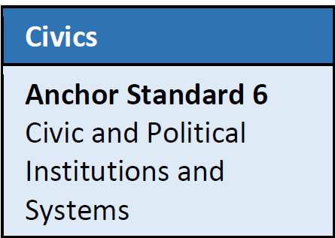
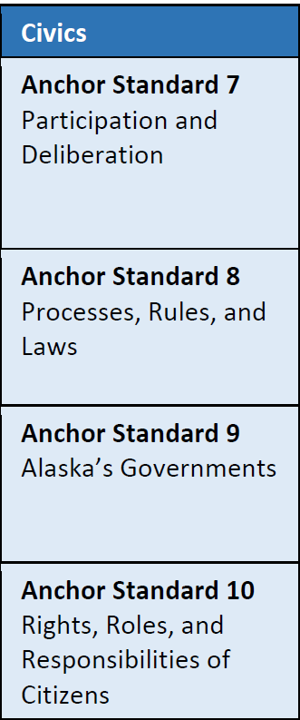
Civics Skills Anchor Standards
Takeaway:
At each grade level, students will engage with civics standards guided by the concepts in the following anchor standards.
Definitions for each anchor standard are provided in the standards document.

Slide 35
Importance of Incorporating Civics into the Classroom
Civics education equips students with the tools necessary for meaningful participation in society, fostering a culture of engaged and informed citizens.
Productive Student Discourse
Teaching respectful communication, promoting active listening, and encouraging diverse viewpoints helps students navigate disagreements constructively and build their critical thinking skills, essential for civic participation.
Taking Informed Action
“Students take Informed Action when they use the key findings from a sustained investigation of content to design and implement an action that impacts the world in a meaningful way” (InquirED). It includes making decisions or participating in activities (such as voting, advocacy, and community service) based on evidence, reasoning, and understanding of civic responsibilities.
Understanding Civics
Civics education provides foundational knowledge of government, democracy, and civic responsibilities. Students learn concepts like rights, laws, and community engagement.
Notes:
8 min

Slide 36
Retrieval Practice:
Chat Waterfall
Prompt:
List: 4 Key Shifts in the new AK Social Studies Standards?
**Extra Credit:
List key takeaways for the 4 shifts**
Procedure:
Write your response in the chat
Don’t press enter till the instructor says so
Everyone submits their response at once

Slide 37
Stop & Synthesize: Discuss
Given the key instructional shifts, what are the implications of the new AK Social Studies Standards for your district, school, or classroom?
1. Thematic Social Studies Content and Skills | 2. Incorporate and Honor Alaska History and Tribal Government | 3. Understand Social Studies through Inquiry | 4. Develop Civic Knowledge, Skills, and Dispositions
Students build deep social studies content knowledge and skills by connecting learning thematically across disciplines. | Students engage with content that reflects their state’s diverse communities, cultures, perspectives, and voices across the social studies disciplines. | Students engage in productive struggle by investigating and asking questions grounded in social studies content and skills. | Students consistently develop and engage with civic knowledge, skills, and dispositions to become active and informed citizens.

Slide 38
Framing
Objective: We will…
Introduce the new ELA / Social Studies Content Specialist
Unpack regulatory context for the new AK Social Studies Standards
Unpack the 4 Key Shifts of the newly adopted AK Social Studies Standards
**Use and highlight some low-prep, high-leverage literacy best practices as we go**
Close: I will…
Summarize:
The 4 Key Shifts of the newly adopted AK Social Studies Standards
Key takeaways from this webinar
Launch:
Download the Implementation Checklist

Slide 39
Close:
Chat Waterfall
Prompt:
Summarize:
The 4 Key Shifts of the newly adopted AK Social Studies Standards
Key takeaways from this webinar
**Extra Credit:
What are some implications for your district, school, or classroom?
Procedure:
Write your response in the chat
Don’t press enter till the instructor says so
Everyone submits their response at once

Slide 40
Part 4:
Launch:
Download the Implementation Checklist

Slide 41
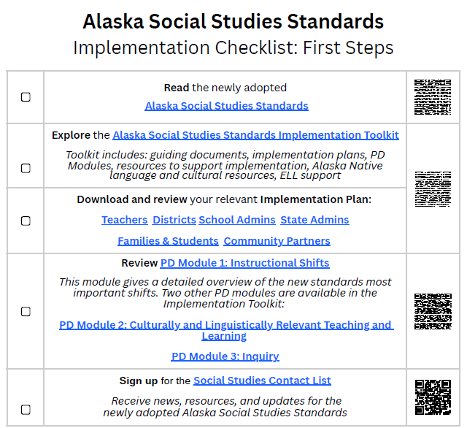
1: Download the Implementation Checklist education.alaska.gov/standards/social

Slide 42
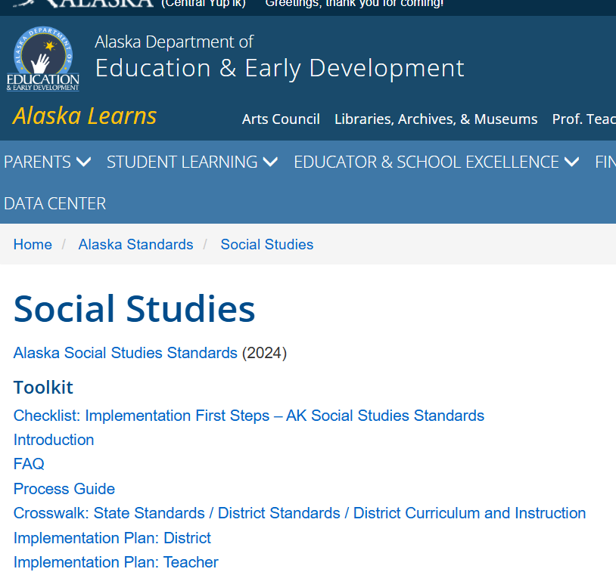
1: Download the Implementation Checklist

Slide 43
2: Open the new Alaska Social Studies Standards
**Homework:
Read the new standards**

Slide 44
3: Explore the AK Social Studies Standards Implementation Toolkit: education.alaska.gov/standards/social

Slide 45
4: Download and review your relevant Implementation Plan from education.alaska.gov/standards/social

Slide 46
5: Review PD Module 1: Instructional Shifts

Slide 47
6: Sign up for the Social Studies Contact List through the last link on the Implementation Checklist

Slide 48
Thanks & Contact Information
Curtis Jensen
ELA / Social Studies Content Specialist - AK DEED
curtis.jensen@alaska.gov
(907) 465-2830
**Reach out via email if you’d like to schedule time during ‘office hours’ to chat more about the new AK Social Studies Standards**

